Slide 1

未來 MIRAI
Demand Forecasting of the Future
Notes:
We present to you MIRAI – Demand Forecasting of the Future
In Japanese MIRAI means – the future

Slide 2
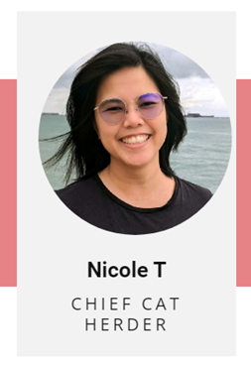

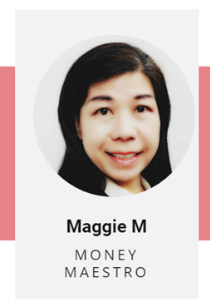

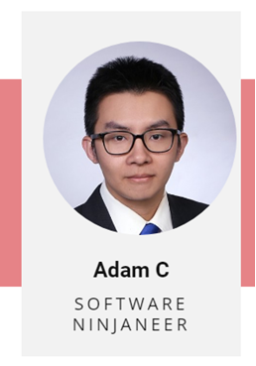
Team MEMBERS
SCRUM MASTER
PRODUCT OWNER
BUSINESS ANALYST
TECHNICAL LEAD
TECHNICAL ANALYST
YiZhou H
Jonathan S
Panasonic
Mentors
Debdeep P
Chye Joo L
Gayathri S
Notes:
Introducing our Team Members
Starting with me, Nicole as the Scrum Master
Jeremy as our Product owner
Maggie our BA
Beatrice our Technical Lead
And Adam our Technical Analyst
We are also happy to have with us our stakeholders
Panasonic
Mentors

Slide 3

AGENDA
Product
Persona
Value Proposition
Variables of Demand Forecasting
Benefits
Implementation
Methodology
System Architecture
Demo
Economic Value
Q&A
Notes:
Moving on to the agenda for the day
We will first cover the product
Introducing the persona,
Our value proposition
Diving into Variables of Demand Forecasting and the benefits that MIRAI brings
Moving on to the next segment - we will cover the implementation strategy
Which includes the methodology and framework, system architecture, demo and finally Economic Value
We will then end with a Q&A, if you have any burning question, feel free to put it in the chat and we will address it at the end of the presentation.

Slide 4

PERSONA
Goal:
Lead his team to deliver sales results
Challenges:
Researching is time-consuming
Missing qualitative inputs
Translating News into forecast levers
Current Tools:
MS Excel, Google
Nakamura​ Tada 中村 多田
40 years old
Regional Sales Director at Panasonic
Favourite Quote: "Today, people are information-rich and time-poor."
Notes:
It’s 9pm at the office. The last few people are leaving. Goodbyes have been exchanged, and words of encouragement shared with one particular person.
Who is that? It ls looks like it's Nakamura-san...
Let me introduce you to Nakamura san – the Regional Sales Director at Panasonic. Looks like he's hard at work still in front of his screen,
updating next quarter's forecast. He's at it again. Do this look familiar?
Can you imagine yourself at the beginning of each quarter of your sales forecast?
- Compiling excel sheets, into power point
- Having meetings and lots of discussions to get the numbers right
As a person who is driven by data, he does not want to rely on quantitative data alone,
He spends several hours to consolidate information from the news and media announcements. .
However, he just does not have enough time to analyse all the information. He spends many evenings each quarter
He wishes that he has more time to strategize and to lead his team to deliver good sales result.
He is tired, its late, he wants to go home. He just wished he could find a way to automate this.
Otsukaresama desu, the last sales person just left the office for the day
Otsukaresama desu a common greeting at the end of the day, literally means You’re tired

Slide 5
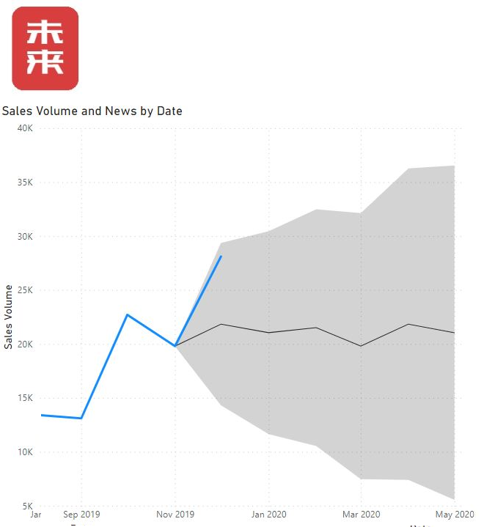

Value Proposition
未来 MIRAI enables data savvy Sales and Marketing professionals to incorporate non-structured data into Demand Forecasting to make better decisions.
Notes:
Introducing Mirai – our system which helps sales and marketing professionals like Nakamura-san make better forecasting decisions based on AI-driven insights. What does a future with Mirai look like? Let's jump right in.
Imagine a product that can alert and notify Nakamura-san when something would impact his demand, he could use the data to drive his sales.
Jeremy :-
(Don’t show slide yet)
Imagine a tool that speeds up Nakamura-san's analysis process, show him what he needs to be concerned about and the "5 W's": What, Where, Who, When, and most importantly, why.
Imagine, a product that shows him exactly what may be impacted, what he needs to manage quickly, and what opportunities can be created or capitalized on.
Imagine, a solution that allows Nakamura to do what is most important to himself, his team, and the organization: to create sales, and close them... To add to the company's bottom-line...
Imagine, to free up his most precious resource: time, and allow pro-active engagement …
…these are the value propositions, No! Brand Promise! We intend to deliver.
(SHOW SLIDE)
Introducing… MIRAI..! (Previously known as The Oracle)

Slide 6
Variables affecting Demand forecast
Quantitative
Qualitative
Historical Sales
Current Events
Management Target
Industry Performance
Economic Data
Government Policies
Notes:
Data can be grouped as – Quantitative or Qualitative. Far more data exists in the qualitative (or non structured) than quantitative nature and it provides a rich source of business intelligence if one has the technology and tool to find the pattern from the data.
Some variables affecting Quantitative data are: the Historical Sales, Management Target and Economic Data.
Qualitative data are affected by:
1) current events that may have impact on the company’s manufacturing plans;
2)Data on industry Performance has effects such as a shortage of components will impact the company's raw materials;
3)And government’s Policies change for example CO2 emission policy affecting the production of cars
Being able to analyse both types of data allows the company to have more accurate demand forecasting. That means having the right amount of raw material according to production plan, having the inventories produced according to market’s demand and reducing opportunity costs for over- or under- stocked inventories.

Slide 7



BENEFITS
Integrates news with existing quantitative demand forecasting systems
Free up time
Zoom into relevant news and extract the business intelligence for decision making
Notes:
What are the benefits? Plenty! Mirai resolves Nakamura san's pain points:
It integrates the latest development in news with existing quantitative demand forecasting systems automatically
He does not have to manually trawl through tons of news articles; this Frees up hours for Nakamura san! And having Mirai do it Reduces the chance of missing out on new developments
Zoom into relevant news and extract the business intelligence for decision making
Leave the repetitive work to machine and focus on the analytics where business decisions are made;

Slide 8
Project Implementation
Notes:
Thank you Maggie
I will now share with you how we implemented the project with Panasonic

Slide 9


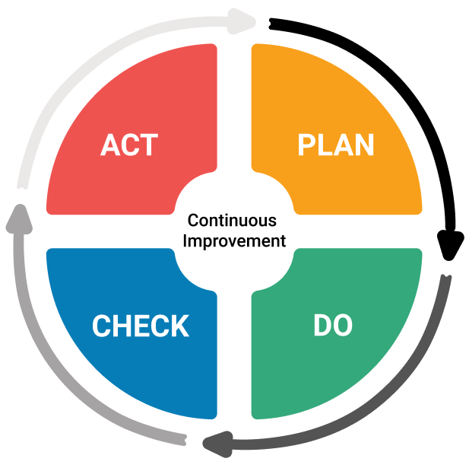
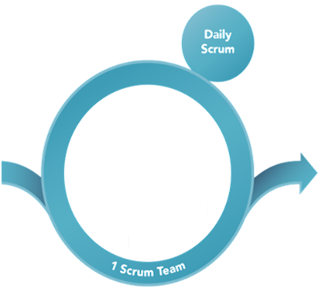
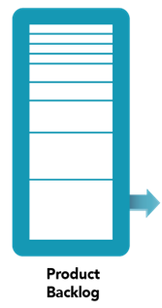

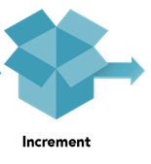
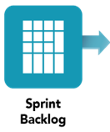
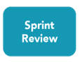
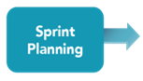



Kaizen Continuous Improvement
Panasonic
Data Science Team
Debdeep
YiZhou
Gayathri
Jeremy
Maggie
NUS Mentors
Nicole
Adam
Jon
Beatrice
Chye Joo
2 Weeks Sprint Cycle
Notes:
We followed the Kaizen Continuous Improvement methodology of Plan, Do, Check and Act closely
Since we were new to all concepts of AI/ML and Demand Forecasting, therefore splitting the scope into bite size pieces through the Scrum Framework worked well for us
Starting with Planning, we defined the scope together with our stakeholders – Panasonic’s Data Science Team and NUS Mentors
Then splitting the scope into smaller portions in a product backlog, we were able to deliver value quicker and learn, adapt and improve along the way
In 2 week sprints, we started with sprint planning, picking up items from our product backlog into the sprint backlog,
We then started to DO – we had daily scrum meetings, and produced increments at the end of the sprint
Not forgetting to CHECK - we presented our deliverables during the sprint review/demo sessions with our stakeholders.
And ending with ACT – we captured our learnings through a sprint retrospective and added any additional requirements based on the feedback we gathered back to the product backlog

Slide 10
Journey with Panasonic
SPRINT 0
1 Aug – 17 Aug
Stakeholder Meeting
Workshop on Product Planning & Project Scope
Workshop on Sales/Supply Chain Management
CS124 Stanford University (NLP)
SPRINT 1
18 Aug – 2 Sep
Cause and Effect Identification
Identify Data
Data Visualization
Model Training
Model Evaluation
Multi-class Classifier
SPRINT 2
5 Sep – 22 Sep
Cause and Effect Optimisation
Data Preprocessing
Oversampling for Imbalanced Data
N-Gram Vectorization
SVM Linear Kernel
Binary Classifier
SPRINT 3
10 Oct – 20 Oct
Temporal Information Extraction using Spacy w BERT
Product Development – Powerpoint prototype, PowerBI prototype
SPRINT 4
7 Nov – 1 Dec
Product Development
Company Website Development
Web App Development – python prototype hosted on Streamlit App
Database
Basic understanding of Data Science
Best F1-Score Model
Accuracy: 53%
F1-Score: 0.83
Best F1-Score Model
Accuracy: 96%
F1-Score: 0.84
Time tagging and extraction
Product Vision
Prototype version 1 (Demo)
Skills/Tools Utilized
Applied SCRUM: Collab tools - MURAL & MIRO, KanBan, TEAMS
Python Libraries: Pandas, Numpy, SKLearn, Seaborn, Matplotlib, NLTK, Spacy (w BERT), Regex
FrontEnd/Middleware/Backend: Streamlit, MySQL, NEWSApi
DevOps: Github, Google Colab
Notes:
Diving into the individual sprints
We started off with Sprint 0, which was the exploration phase
In this phase we were introduced to our mentors and stakeholders at Panasonic
Had workshops and online trainings to learn about Sales, Supply Chain Management, and Natural Language Processing
And defining the project scope with our stakeholders
Sprint 1 we started of with Cause and Effect identification – we managed to deliver our first model with accuracy & F1 score
Sprint 2 we focused on model optimisation – achieving an accuracy of … which was well received by Panasonic, to be optimised further with their internal data
Since we were able to deliver the initial scope earlier than planned, we extended the scope to Temporal Information Extraction and Product Development
Sprint 3 we delivered the model for time tagging and extraction using Spacy with Bert, Panasonic appreciated that we found a more effective model
Moving on to Sprint 4, we focused on Prototype development on Streamlit producing a Minimum Viable Product

Slide 11








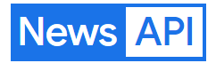



System Architecture
MIRAI
User
User Interface
Web App
NLP Models
Database
News Sources
(Qualitative)
Notes:
Next, going into the system architecture
Starting with the news source from WebScraper provided by Panasonic, and using NewsAPI
We integrated the data into MySQL
Streamlit automatically containerise the application with our NLP Models
And provides a clean and interactive user interface for the user
We had considered using PowerBI for developing this solution due to the easy integration of excel files into PowerBI. However, PowerBI supports a limited number of python libraries and had constraints to make further customisations to the interface. Important NLP related libraries like spaCy are also not available for use within PowerBI.
We looked for a platform to run python codes easily and without restrictions on the libraries. Streamlit was our chosen platform for the development of this web app, as it offers an open-source app framework for running python codes.
Beatrice will share about the process flow and the demo

Slide 12
MIRAI Process Flow
Extract relevant news articles
Identify events which have an impact on demand
Extracting events and the time features associated
Assigning a "score" to each extracted event which indicates impact on demand
Adjusted based on news
Web Crawler
Cause-Effect Modelling
Temporal & Event Extraction
Sentiment Analysis
Demand Forecast
Notes:
Together with the data science team at Panasonic, we are proposing a pipeline of 4 modules to build a demand forecast model based on news articles. In this pipeline, we start off with a web crawler which extracts news articles from news sources like Reuters, BBC, CNN. Panasonic, had already built such a web crawler prior, and thus, we did not replicate the work they had already done.
The second module in this pipeline is a cause-effect model. This module helps to establish relationships between events. Passing relevant data through the model can help to identify events that have a causal relationship with the demand. This will help focus the subsequent modules in our pipeline on relevant events, instead of all events.
The third module is a temporal and event extractor, which extracts events and time features associated with these events from the news article. This is important in identifying when specific events will happen.
The fourth and last module works towards establishing a quantitative relation between events and the demand so that these events could be used to adjust the demand forecast. A score could be assigned to each extracted event, with the score indicating a certain percentage impact on the demand.
Together, these models allow for a demand forecast adjusted based on news.
For our project with Panasonic, we have focused our efforts on developing the cause-effect model, and the temporal extractor, given the limited time we had. In addition, we also developed a prototype for a product that would integrate news data into a demand forecast dashboard. The design of this prototype will be covered next.

Slide 13

URL: https://beatriceyapsm-capstonebackend-backendapp-t5spbq.streamlit.app/
Notes:
We conducted an interview with a sales and marketing professional to flesh out what would be a useful for a user of such a dashboard.
Let me walk you through the key features in the app we built with python, hosted on streamlit.
Easy uploading/integration of data in excel format (as Panasonic uses excel, and from our research up to 50% of companies still rely on spreadsheets for forecasting)
View plotted line chart and provide an interactive experience to zoom in and out on certain parts of the trend line and forecast
View indicators for news events on chart
View news and projected impact in table below
Ability to allow for user-input data with regards to the percentage impact of the event and saving this user-input data to a database. For example,

Slide 14
FUTURE SPRINTS
SHORT TERM
Complete model development
Integrating and Deployment within Panasonic’s landscape
User training and model reinforcement through user input
LONG TERM - expansion
Other EV products, ie Automotive Cockpit, etc.
Other divisions, ie Connect, Industry, Energy
Operations, manufacturing, finance
Notes:
Given our short time frame for developing this product, we recognise that the work is not complete in develop the full end-to-end solution for qualitative demand forecasting. In order to develop this, the next few sprints will focus on the modules for event extraction and event scoring. In addition we will need to work on integrating the model and deploying them within Panasonic's landscape. For machine learning models, the more inputs are available, the more accurate the model becomes, thus, our focus will be to train users and collect their inputs to reinforce the model.
For the long term goals, we will focus on expanding the use of the product to other related products and divisions within Panasonic. However, we also see good applications of this product in the operations and manufacturing sectors with high value inventory or high-inventory turnover in which the safety stock kept could be at high levels.

Slide 15

Link to Code and model
URL: https://github.com/squaluz/Group-9C-Capstone

Slide 16
Economic Value

Slide 17
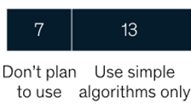
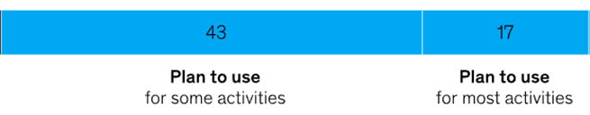
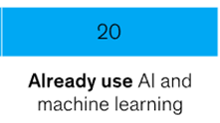
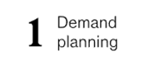
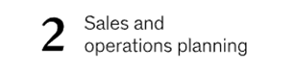
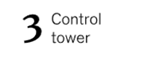
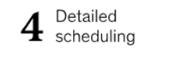
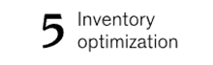
Competitive Advantage
20%
60%
20%
Top Applications being considered
Source: McKinsey Survey of Global Supply-chain Leaders (2021)
https://www.mckinsey.com/capabilities/operations/our-insights/to-improve-your-supply-chain-modernize-your-supply-chain-it
Notes:
According to a survey conducted by McKinsey in 2021, 20% of businesses have already incorporated AI and machine learning into their operations. Furthermore, 60% of businesses plan to adopt this technology to facilitate some or most of their activities. The no.1 application being considered is demand planning.
It is clear that Ai and Machine learning offer substantial competitive advantages to the business, and the economic benefit of implementing the system can justify the cost.
This is why Ai and machine learning are so attractive to those participants in this survey.

Slide 18
Why are businesses using it?
Up to 50%
reduction in forecast errors with machine learning
Up to 65%
Reduction in lost sales due to product unavailability
Up to 50%
Reduction in inventory
Source: McKinsey, Smartening up with Artificial Intelligence (AI) - What’s in it for Germany and its Industrial Sector? (2017)
Notes:
So what can Ai and Machine learning help to improve the business?
Machine learning can reduce forecast errors by up to 50%. It also prevents business lost sales due to product unavailability and reduces 50% of inventory.
All of these means businesses can operate to achieve their maximum potential.
Mirai is here to deliver real value to our partner to achieve that. (NEXT PAGE)

Slide 19
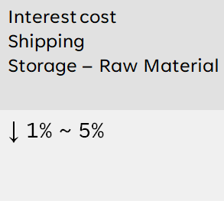
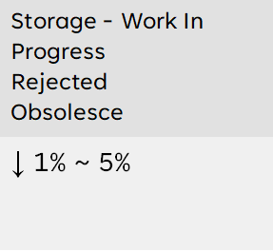
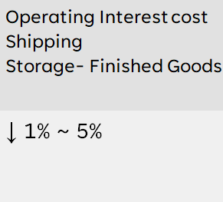
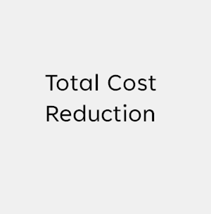
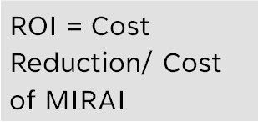
Value chain analysis
MIRAI
ROI ~ 15x
Notes:
With Mirai, Businesses can have real-time and highly accurate demand forecasts, which ultimately lead to making smart business strategies. For example, the system detected a potential demand increase in the next few months.
If we look at the slide here, Inbound Logistics, Operations and Outbound Logistics regarding Panasonic’s Annual report.
Inbound - The business can plan and arrange its future operation in advance to get an early bird discount.
Operations - Because of the optimization in its operation, the timeline of this whole process reduces, the means the interest incurred will also decrease.
Outbound - The need for storage will also be cut.
considering the cost reduction for the business,
With the assumption of a 1% to 5% cost reduction in each component, we find that having MIRAI would provide a minimum ROI of 15 times.
This number is highly achievable.
next, I will pass to Nicole for the rest of the presentation

Slide 20


“Without data, you're just another person with an opinion”
W. Edwards Demming
URL: https://mirai9c.netlify.app/
Notes:
As Edwards Demming said – Without data, you are just another person with an opinion
I hope our presentation has made you aware that there is so much more we can do with data, AI and ML is here to help automate it.
Scan this QR code to learn more about us and the demo and link to our github page
Before we end our presentation for the day, I would like to have Panasonic share their sentiments about the project.

Slide 21
Q&A
Thank you for YOUR ATTENTION
Notes:
Thank you for your time, we would like to open the floor to any Q&A

